Slide 1
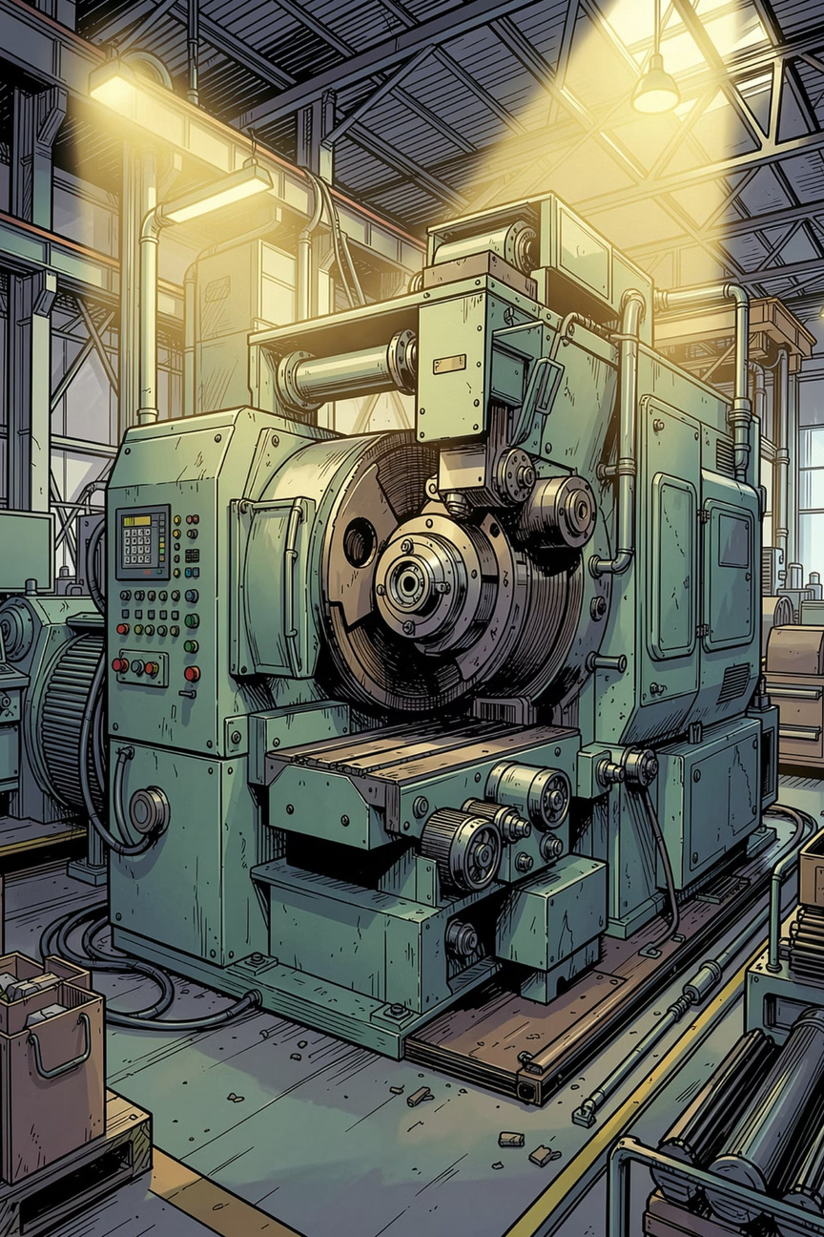
AI-Based Predictive Maintenance and Process Intelligence System
Infosys Internship 2026 (Milestone 1)
Team 1
Presented by Aliya , Arya , Ankit , Akshata, Tanmayee , Prudhvi
Notes:
1

Slide 2
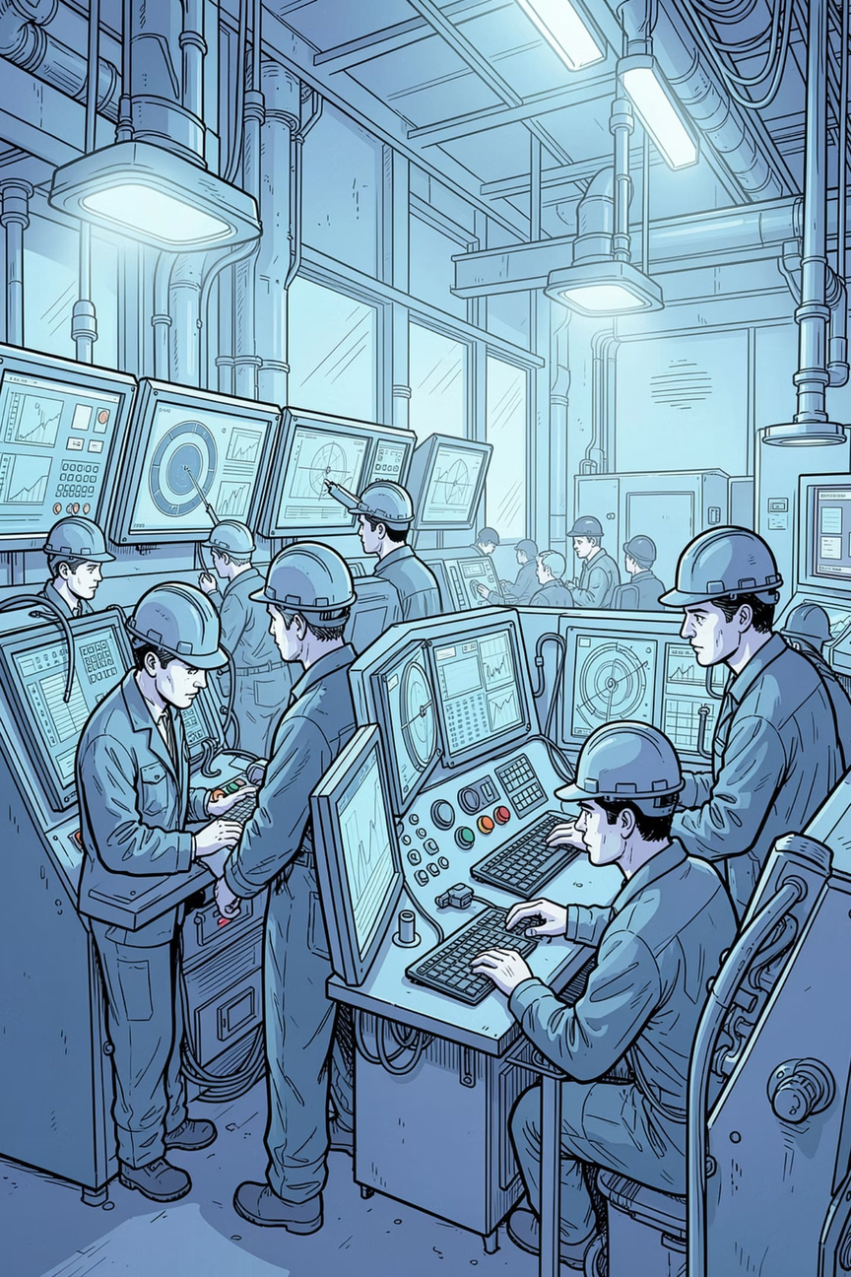
Introduction
The Problem
Unexpected machine failures can cause:
Production downtime
High maintenance costs
Lower productivity
Predictive Maintenance
Predicts equipment failures using AI and sensor data.
Enables proactive maintenance.
Process Intelligence
Analyzes workflows and operational data.
Identifies inefficiencies and improves processes.
Notes:
2

Slide 3
Project Objective & Overview
Objective
Develop an AI-based system to predict machine failures and optimize industrial processes.
Primary Goals
High-level Workflow
Predict failures early
Reduce downtime
Lower maintenance costs
Improve equipment life
Enable data-driven decisions
Sensor Data → Data Processing → AI Model → Failure Prediction → Maintenance Insights
Expected Impact
Increased reliability
Higher productivity
Better operational efficiency
Notes:
2

Slide 4
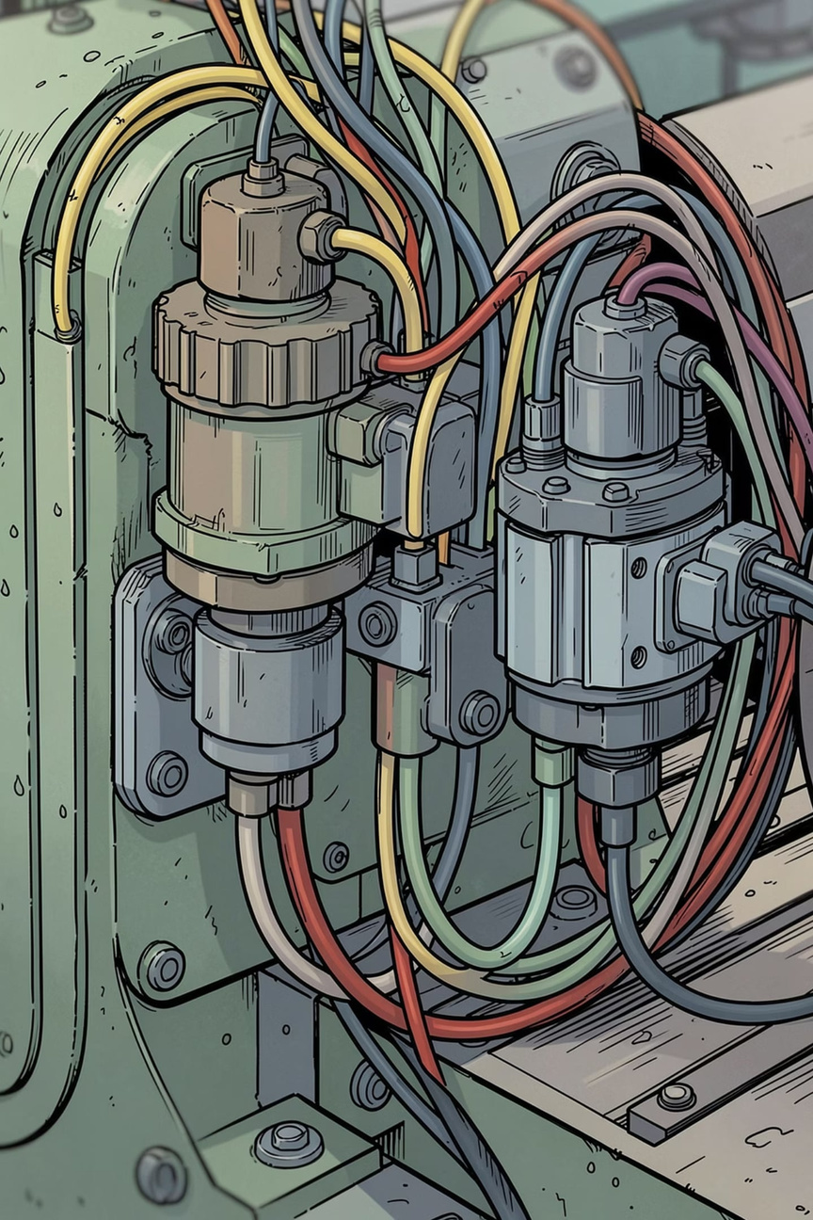
The AI4I 2020 Dataset — Industrial Foundation
Synthetic but realistic dataset modelling milling-machine behaviour: ~10,000 records, 14 core features (temperatures, speed, torque, tool wear) and a binary Machine Failure target. Contains multiple labelled failure modes (TWF, HDF, PWF, OSF, RNF).
Key Features
Target & Labels
Air & process temperature (K)
Rotational speed (RPM)
Torque (Nm)
Tool wear (minutes)
Product ID, Type (categorical)
Binary failure label (machine_failed) with additional failure-type annotations. Useful for classification and multi-task experiments (failure detection + failure-mode classification).
Notes:
3

Slide 5
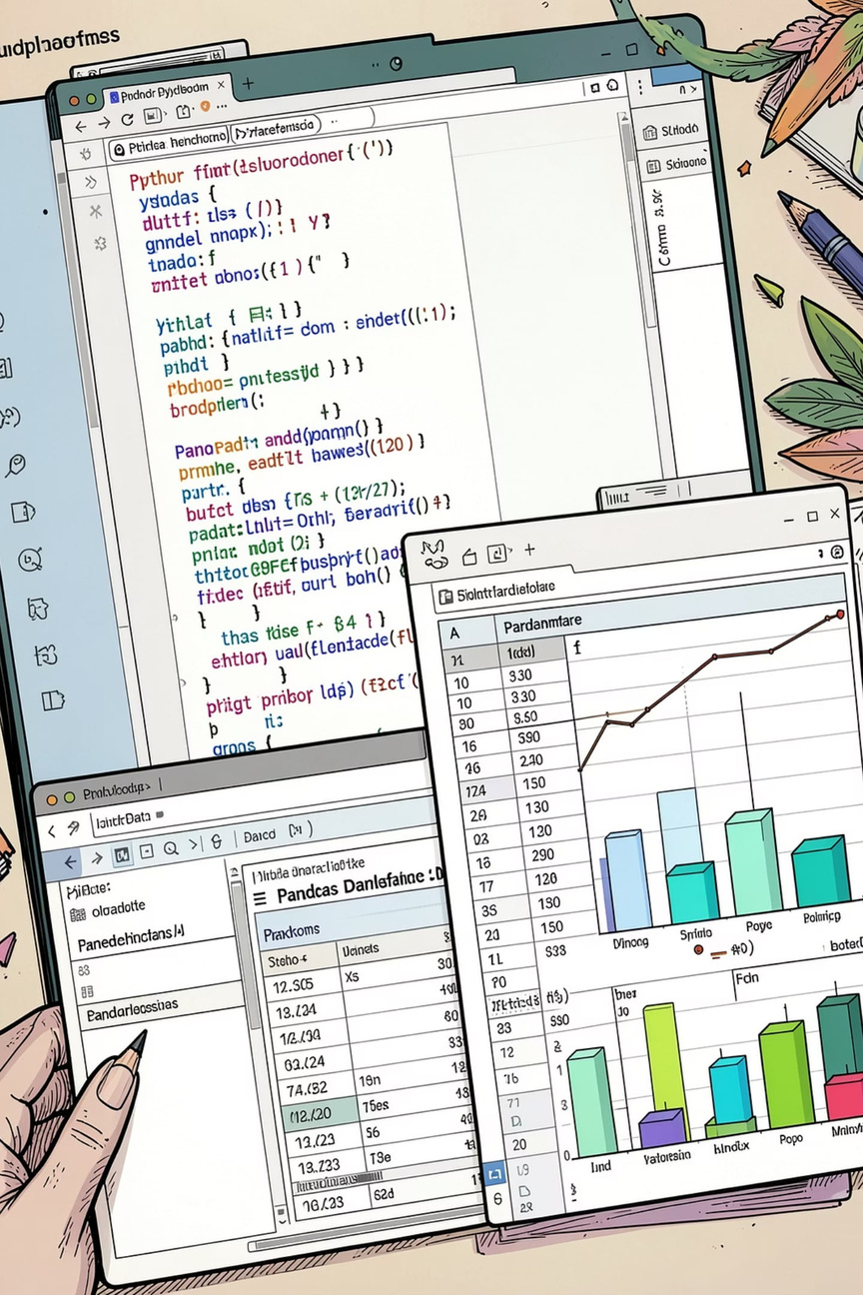
Technical Stack
Language
Python — ecosystem maturity and library support
Pandas, NumPy — ingestion & transformation
Data
Viz
Matplotlib, Seaborn — exploration and reporting
Modeling
Scikit-learn, XGBoost, PyTorch/TensorFlow for deep models
Notes:
4

Slide 6
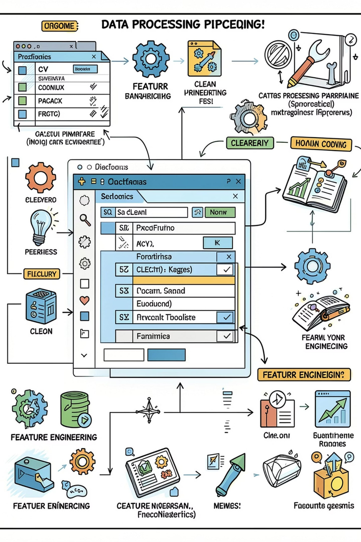

Data Preprocessing Strategy
Concise, repeatable pipeline to prepare sensor data for robust modelling.
01
1. Ingest & Clean
Load CSV, check nulls, remove duplicates, validate ranges
02
2. Encode & Select
One‑hot / label encode Product Type; drop UID/Product ID when appropriate
03
3. Scale & Balance
StandardScaler or MinMax; use SMOTE or class weights for imbalance
04
4. Split & Validate
Stratified train/test split (80/20), cross‑validation, and hold‑out for final evaluation
Notes:
5

Slide 7
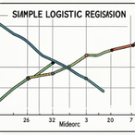
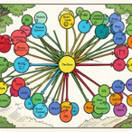

ML Implementation — Part 1 (Models A, B, C)
Logistic Regression
Decision Tree
Random Forest (Recommended)
Baseline classifier — interpretable, fast. Good for calibration and benchmarking; limited for nonlinear sensor interactions.
Interpretable splits, handles nonlinearity and categorical features; prune to avoid overfitting.
Ensemble approach: high accuracy, robust to noise, feature importance for explainability. Strong baseline for tabular sensor data.
Notes:
6

Slide 8
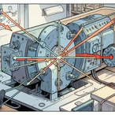


ML Implementation — Part 2 (Models D, E, F)
Support Vector Machine (SVM)
XGBoost (Recommended)
Artificial Neural Network (ANN)
Effective in high-dimensional spaces; kernelised SVMs capture complex boundaries but scale poorly to large datasets.
State-of-the-art on structured data: gradient boosting, regularisation, built-in handling of missing values, strong predictive power.
Captures complex nonlinearities; use MLP for tabular data or combine with feature embeddings. Requires careful tuning and more compute.
Notes:
7

Slide 9
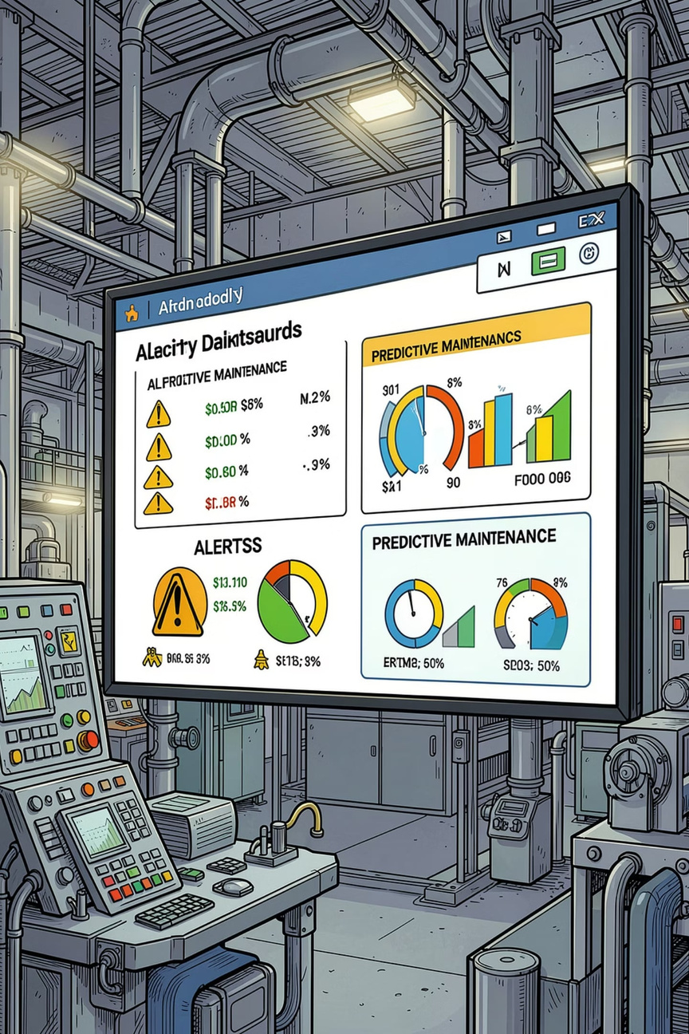
Expected Outcomes & Applications
Outcomes
Industrial Applications
Early failure detection → fewer unplanned stops
Reduced spare-part inventory via targeted scheduling
Improved OEE and cost savings
Manufacturing lines, CNC/milling tool monitoring, rotating equipment, and multi-site fleet maintenance. Business impact: predictable uptime, safety improvements, and data-driven decision making.
Notes:
8

Slide 10
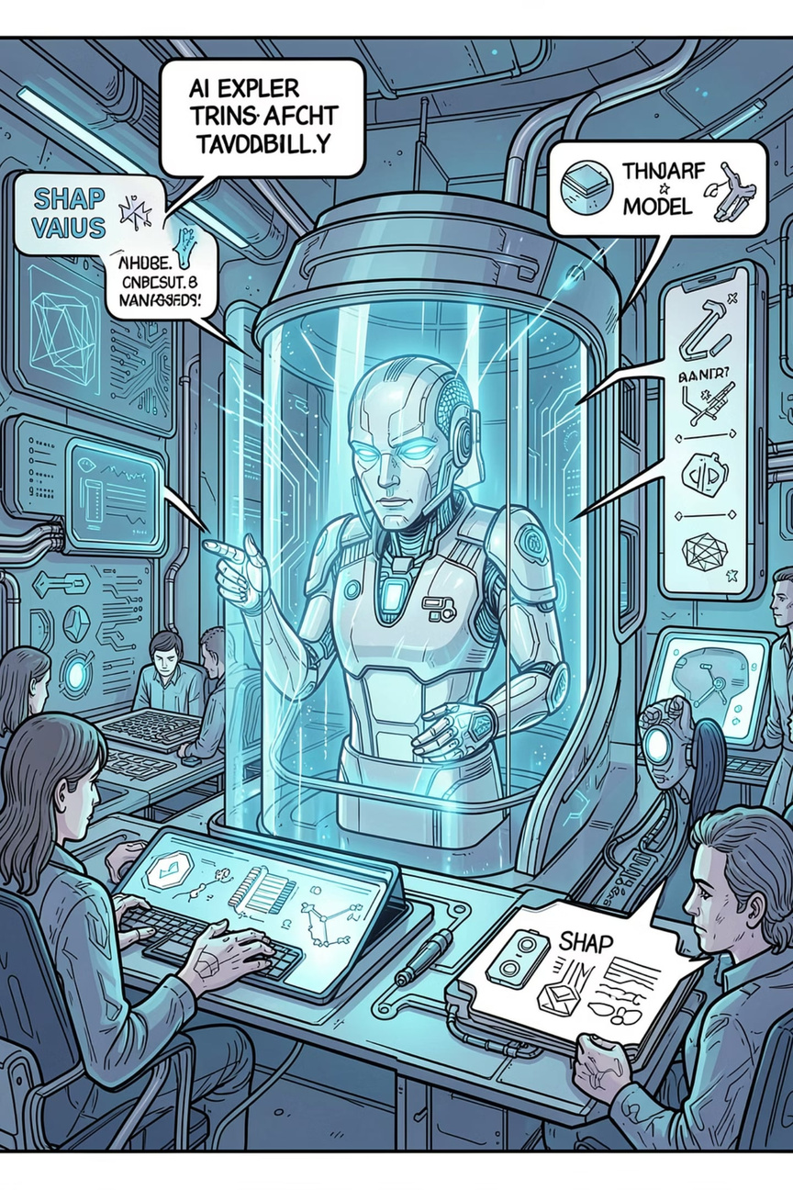
Conclusion & Future Scope
1
2
Conclusion
Future Enhancements
Predictive maintenance converts reactive costs into strategic operational advantage. Balance metrics (precision vs recall) to align with maintenance cost and risk tolerance.
RUL estimation (regression), time-series models (LSTM/CNN), real‑time IoT streaming, cloud monitoring, and Explainable AI (SHAP/LIME) for operator trust.
Notes:
9

Slide 11

Thank You
https://github.com/gprudhvi2005/AI-Based-Predictive-Maintenance-and-Process-Intelligence-System
Notes:
10

